Slide 1
Using Machine Learning, Red Hat Process Automation Manager (BPM Suite), and Reactive Microservices
S1506
Andy Bonham, Distinguished Engineer, Capital One
Hrishi Menon, Lead Software Engineer, Capital One
Murph, Solutions Architect, Red Hat
May 10, 2018

Slide 2
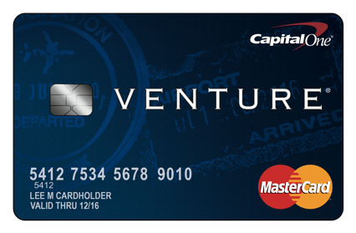

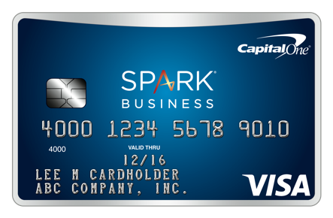
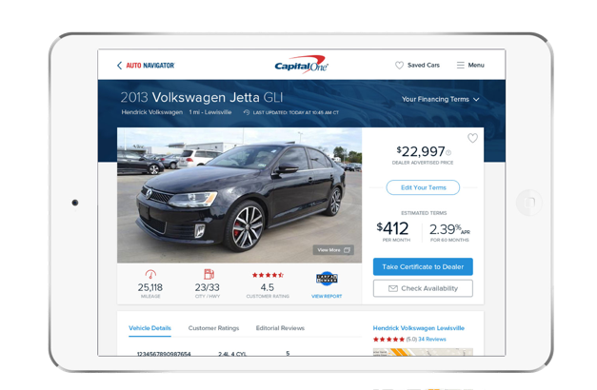

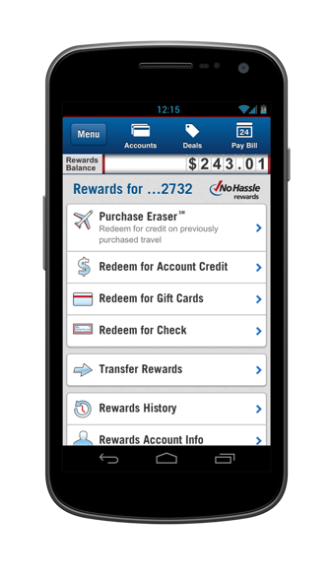


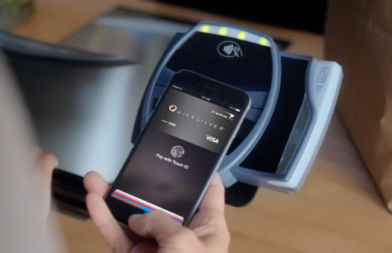
Capital One at a glance
A leading diversified bank with $365.7 billion in assets, $255.4 billion in loans and $243.7 billion in deposits¹
8th largest bank based on U.S. deposits²
6th largest retail depository institution in metro New York³
Largest consumer and commercial banking institution headquartered in the Washington, DC region
3rd largest credit card issuer in the U.S.⁴
The 3rd largest issuer of small business credit cards in the U.S.⁵
Largest financial institution auto loan originator⁶
Largest U.S. direct bank⁷
Major operations in 15 U.S. cities, Canada, U.K.
More than 70 million customer accounts and 49,000 associates
A FORTUNE 500 Company - #100
Numerous recent awards including:
Named to 100 Best Companies to Work For by FORTUNE Magazine
Best Places to Work for LGBT Equality by Human Rights Campaign
Received J.D. Power & Associates Call Center Certification
Aon Hewitt’s Top Companies for Leaders
Named to Working Mother’s 100 Best Companies list & Best Companies for Hourly Workers
Ranked #14 on Military Times’ 2017 “Best for Vets”
Recipient of the Secretary of Defense Employer Support Freedom Award
1) Source: Company reported data as of Q4’17
2) Source: FDIC, Domestic deposits ranking as of Q4’17
3) Source: FDIC, June 2017, deposits capped at $1B per branch
4) Source: Company-reported domestic credit card outstandings, Q4’17
5) Source: The Nilson Report, Issue #1111, June 2017
6) Note: Financial institutions includes banks & specialty finance lenders, Source: AutoCount, most recent quarter originations as of October 2017
7) Source: Regulatory filings, company reports as of June 2017
Notes:
2
New images: Tom Givens

Slide 3
We are one of the largest banks in the U.S.
Q4 2017 Total Loans ($B)
Q4 2017 U.S. Deposits ($B)
1. | Wells Fargo | 976.9
2. | Bank of America | 948.2
3. | JPM Chase | 930.7
4. | Citigroup | 688.1
5. | U.S. Bancorp | 283.4
6. | Capital One | 255.4
7. | PNC | 223.1
8. | TD Bank | 154.3
9. | SunTrust | 145.5
10. | BB&T | 144.8
11. | American Express | 127.4
12. | Ally | 123.0
13. | Citizens | 111.3
14. | Fifth Third | 92.5
15. | M&T | 88.0
1. | Bank of America | 1,227.5
2. | Wells Fargo | 1,207.3
3. | JPM Chase | 1,187.3
4. | Citigroup | 445.6
5. | U.S. Bancorp | 321.9
6. | TD Bank | 264.1
7. | PNC | 262.4
8. | Capital One | 243.2
9. | SunTrust | 160.8
10. | BB&T | 157.4
11. | Citizens | 115.0
12. | Key | 105.3
13. | Fifth Third | 103.1
14. | Regions | 97.2
15. | Ally | 93.2
Notes: Excludes banks with high non-loan asset concentrations: Goldman Sachs, Morgan Stanley, BONY, State Street, Charles Schwab. Gross loans and domestic deposit data as of 12/31/2017. Based upon total gross loans and total aggregated domestic deposits for bank holding company
Sources: SNL, FDIC
Notes:
5/4/2018
3

Slide 4
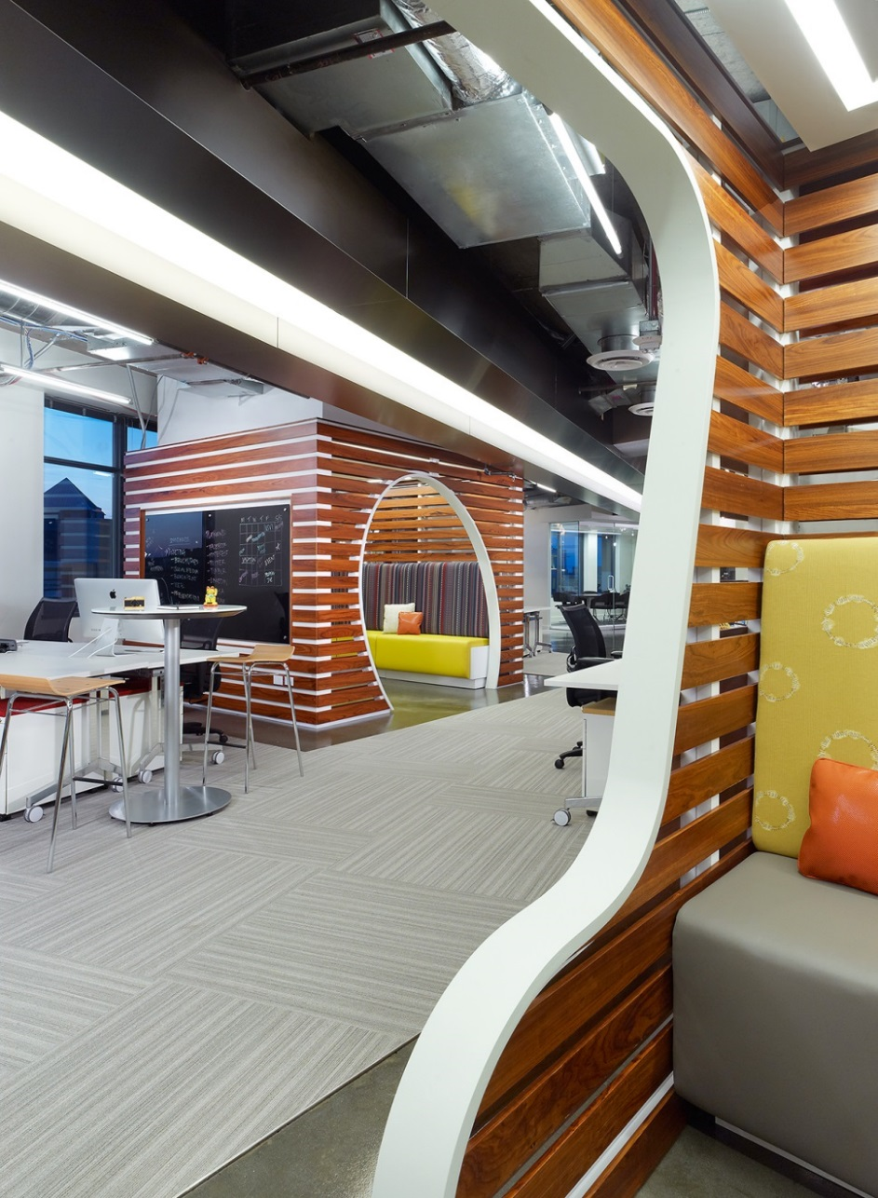
We have transformed the company into a top 10 bank
2017 – Acquires Notch
2016 – Acquires Critical Stack and Paribus
2015 – Acquires GE Capital’s Healthcare Financial Services and Monsoon
2014 – Acquires Adaptive Path, a digital design leader
2013 – Acquires Beech Street Capital, an originator, underwriter and servicer of multifamily commercial real estate loans
2012 – Acquires ING DIRECT, HSBC US Card portfolio
2010 – Enters into card partnerships with Kohl's and Sony in the US and Hudson's Bay Company and Delta in Canada
2009 – Acquires Chevy Chase Bank in the Washington, DC area
2006 – Acquires North Fork Bank, one of the largest banks in the New York metro area
2005 – Acquires Hibernia National Bank, #1 bank in Louisiana
2002 – Launches its Small Business credit card
2000 – Introduces slogan, “What’s in your wallet?”
1998 – Enters Auto Finance Market
1996 – Expands into Canada and the U.K.
1994 – Initial Public Offering (IPO)
Notes:
4

Slide 5




Previously, we presented how you can use BPM Suite, Reactive Microservices, Docker, and ECS
https://github.com/andy9876/ReactiveBPMDemo
BPM Suite for coordinating a reactive workflow
Leverage Kafka as the messaging mechanism between the microservices and BPM Suite
Docker for microservice deployment
ECS for docker container management
In today’s session, we are going to extend this pattern to show how you can integrate with machine learning
BPM Suite
Kafka
RunModelMS

Slide 6

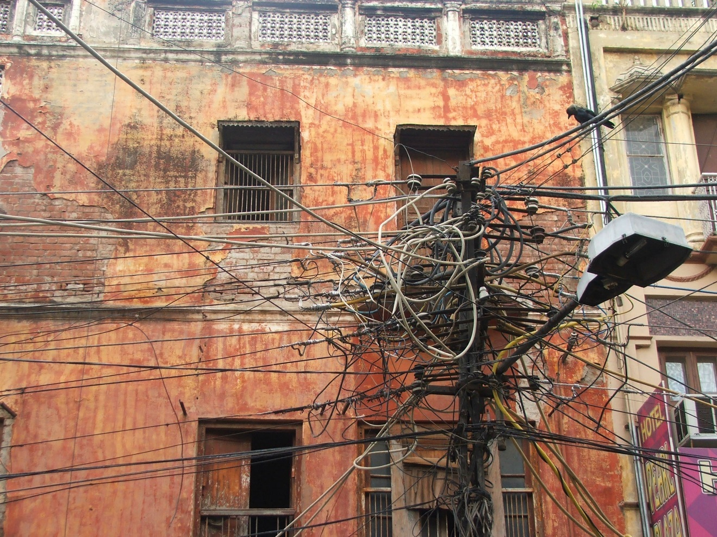

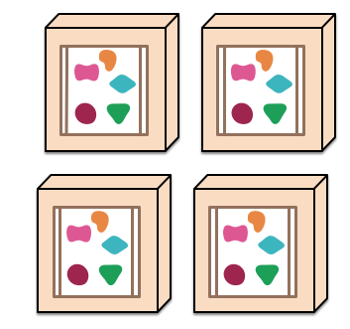
A monolithic application can be challenging…
A monolithic application puts all its functionality into a single process…
… and scales replicating the monolith on multiple servers
Monoliths can have many dependencies
Monoliths are also hard to change
*This illustration is from http://martinfowler.com/articles/microservices.html

Slide 7
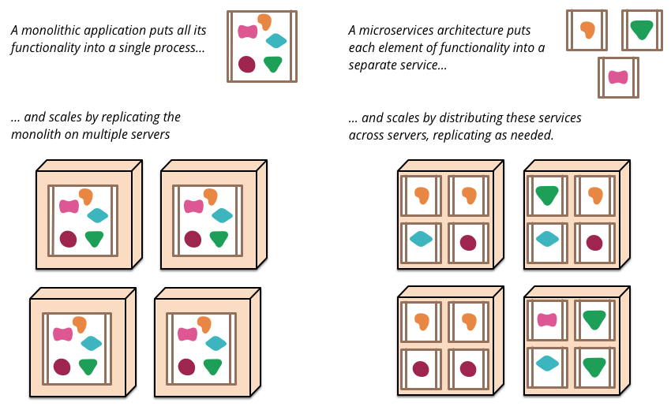
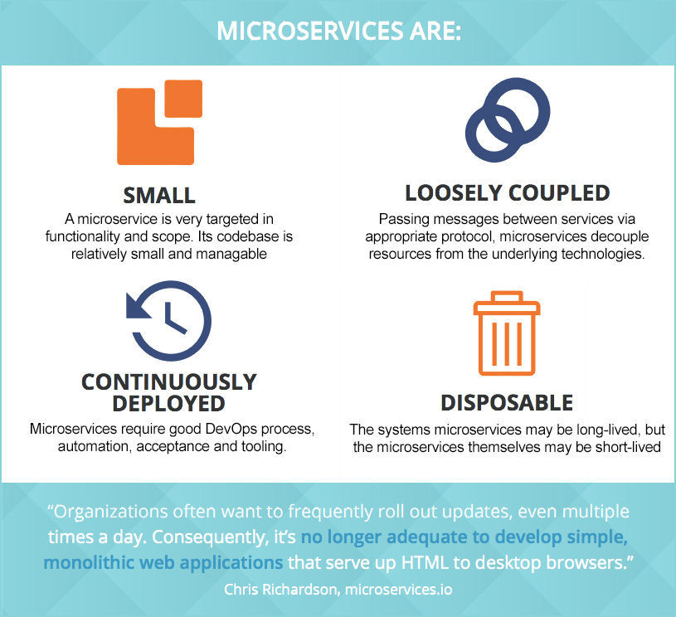
Microservices to the rescue! But are they the silver bullet?
A microservices architecture puts each element of functionality into a separate service…
… and scales by distributing these services across servers, replicating as needed.
*This illustration is from http://martinfowler.com/articles/microservices.html

Slide 8
A reactive architecture leverages asynchronous messaging between microservices
Service A
Service C
produce
produce
Service A
consume
consume
blocking
Event Stream
Orchestrator
blocking
Service B
blocking
consume
produce
Service C
Service B
Notes:
Streams are everywhere and there are an abundance of real-time events that enable a highly interactive experience to the user
Event – something significant that has happened in a domain
Events are immutable
Services are async and can execute at the same time, there is no blocking
The Eventing queue is a dumb channel and not an orchestration engine or elaborate bus. No code or transformations happen in the pipe (typically problems with SOA)
Event Sourcing and CQRS patterns can be applied to add value

Slide 9
In 2013, the Reactive Manifesto was born and highlights the key principles of a reactive architecture
Responsive
Elastic
Resilient
Message Driven
http://www.reactivemanifesto.org/
Notes:
Responsive: The system responds in a timely manner if at all possible. Responsiveness is the cornerstone of usability and utility, but more than that, responsiveness means that problems may be detected quickly and dealt with effectively. Responsive systems focus on providing rapid and consistent response times, establishing reliable upper bounds so they deliver a consistent quality of service. This consistent behavior in turn simplifies error handling, builds end user confidence, and encourages further interaction.
Resilient: The system stays responsive in the face of failure. This applies not only to highly-available, mission critical systems — any system that is not resilient will be unresponsive after a failure. Resilience is achieved by replication, containment, isolation and delegation. Failures are contained within each component, isolating components from each other and thereby ensuring that parts of the system can fail and recover without compromising the system as a whole. Recovery of each component is delegated to another (external) component and high-availability is ensured by replication where necessary. The client of a component is not burdened with handling its failures.
Elastic: The system stays responsive under varying workload. Reactive Systems can react to changes in the input rate by increasing or decreasing the resources allocated to service these inputs. This implies designs that have no contention points or central bottlenecks, resulting in the ability to shard or replicate components and distribute inputs among them. Reactive Systems support predictive, as well as Reactive, scaling algorithms by providing relevant live performance measures. They achieve elasticity in a cost-effective way on commodity hardware and software platforms.
Message Driven: Reactive Systems rely on asynchronous message-passing to establish a boundary between components that ensures loose coupling, isolation and location transparency. This boundary also provides the means to delegate failures as messages. Employing explicit message-passing enables load management, elasticity, and flow control by shaping and monitoring the message queues in the system and applying back-pressure when necessary. Location transparent messaging as a means of communication makes it possible for the management of failure to work with the same constructs and semantics across a cluster or within a single host. Non-blocking communication allows recipients to only consume resources while active, leading to less system overhead.

Slide 10

A reactive architecture has both benefits and tradeoffs
BENEFITS
TRADEOFFS
Better resource utilization, saving cost
Can get higher efficiency out of CPUs (multi-core processors), doing more with less
More Agile
Decoupling enables services to be updated independently
Faster response times as requests can run in parallel
Back pressure can be used for flow control
Fast producers don’t overwhelm slower consumers
Enables a consumer to control queue bounds
Extensible
New components can be added that listen to the event stream without re-writing the system
Async programming is a mind shift
Complexity
The flow of the system is shifted from a central place to distributed services

Slide 11
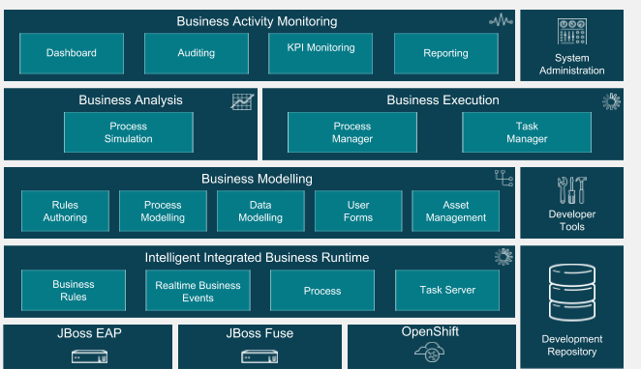
Red Hat Process Automation Manager
Bridges Business and Technical resources together
Leverages BPMN 2.0
Natively integrated with Drools Rules
Supports human workflow and system workflow
Various APIs
Java based and very Extensible
BAM, Dashboards, Reports, Analytics

Slide 12
Kafka is a distributed streaming platform
Used in conjunction with Zookeeper
Runs as a cluster
Records are stored in categories called topics
Provides 4 core APIs: Producer, Consumer, Streams and Connector
Supports both publish-subscribe and queuing through a consumer group concept
Very Fast and has very high throughput – many use it for backpressure
Can be used for message replay as the messages do not have destructive reads like traditional messaging technologies
Guarantees order of messages within a partition, but not across partitions
Very easy to get up and running
http://kafka.apache.org/documentation.html

Slide 13
PAM Kafka Integration – KIE Server
kie-server extension
KIE Server is built on a concept of extensions. All capabilities are implemented as extensions
KIE Server extension
Drools extension
jBPM extension
jBPM UI extension

Slide 14
PAM Suite Kafka Integration – Extending KIE Server
kie-server extension
So we’re going to add one more
KIE Server extension
Drools extension
jBPM extension
jBPM UI extension
Kafka extension

Slide 15
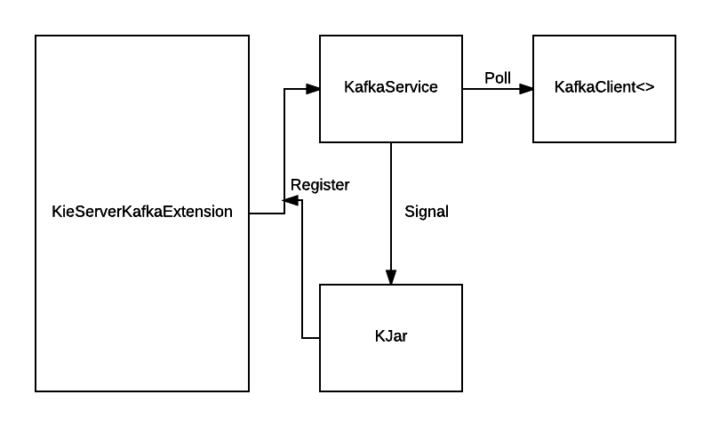
PAM Suite Kafka Integration Architecture

Slide 16

Machine Learning is a type of Artifical Intelligence
Artificial Intelligence
Scripted Chatbots
Medical Diagnosis Expert Systems
Machine Learning
Product Recommendation Engines (Netflix, Amazon, etc)
Spam Filtering
Adaptive Pricing Systems
Deep Learning
Image Recognition
Self-Driving Cars
Siri / Alexa / Google Home / Cortana
1950s
1960s
1970s
1980s
1990s
2000s
2010s
Artificial Intelligence Systems able to perform tasks that normally require humans. E.g., If/then logic
Machine Learning A subcategory of AI that provides ability to automatically train the system. E.g., Regression
Deep Learning MLs with multiple layers that mimic layers of neurons in the brain. E.g., Deep Neural Networks

Slide 17
There are two major classes of Machine Learning
Supervised
A human labels the data used
Labor intensive, but more interpretable
Unsupervised
An algorithm discovers relationships
Easier, but less interpretable

Slide 18
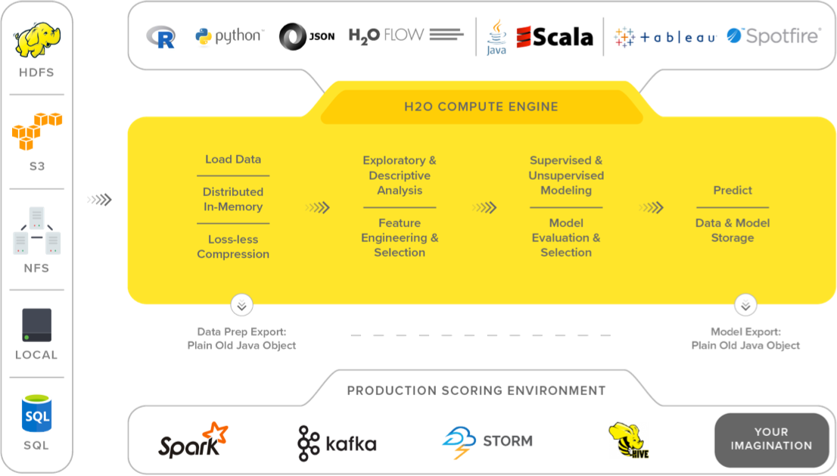
H20 Overview
Open source (Apache license) in-memory big data machine learning platform
Created in 2011 and is written in Java, Python and R
Can be used with Python, R, H20 Flow, Scala, Tableau, Spotfire
Uses parallelized and distributed algorithms like GLM, Random Forest, GBM, PCA, deep learning neural networks
Also supports supervised and unsupervised learning
Deploy model as a Java POJO or MOJO (Model ObJect, Optimized)
Image from https://www.h2o.ai/h2o/

Slide 19

Below are two options for integrating machine learning
Plug into the event stream as another reactive microservice
Integrate directly into BPM Suite as a workitem handler
PAM
PAM
Workitem handlers
Calc Features
Kafka
RunModelMS
Calc Features
RunModelMS

Slide 20
Combining all of these technologies & patterns together can create a powerful solution
PAM for coordinating a reactive workflow
Leverage Kafka as the messaging mechanism between the microservices and BPM Suite
Docker for microservice deployment
ECS/Kubernetes for docker container management
H20 for machine learning
PAM
Kafka
Calc Features
RunModelMS

Slide 21
Demo use case and Machine Learning components

Slide 22
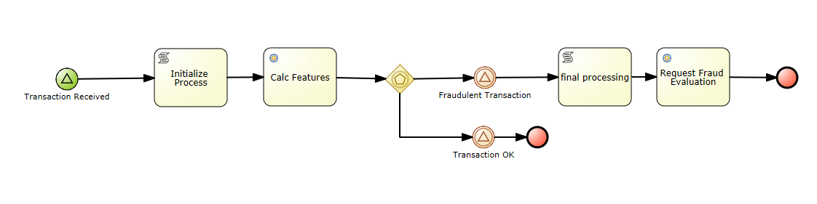
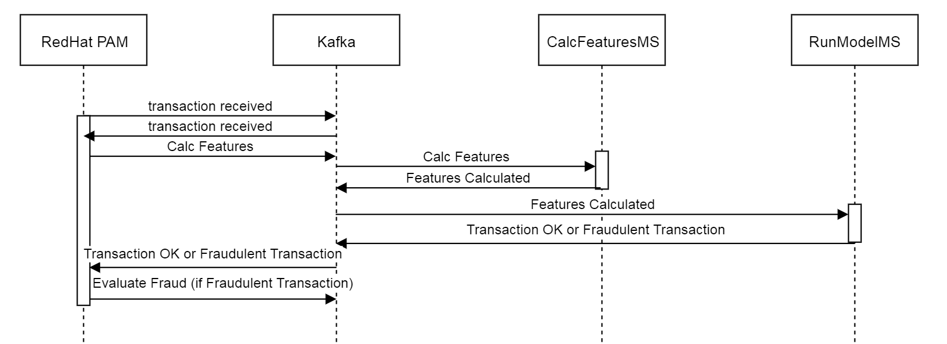
Fraudulent Transaction Use Case

Slide 23
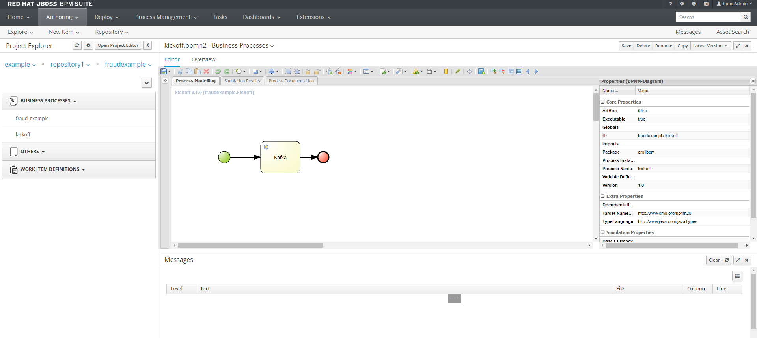
A business process to simulate the transaction
This business process submits the below event to Kafka:
{"id": "33bb75db-6e13-48ee-8a54-b3976d3d065b","action": “Transaction Received"}

Slide 24
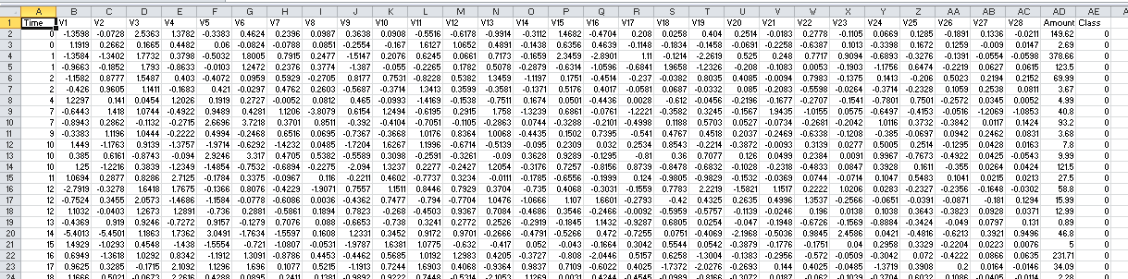
For the machine learning components, we are using a Credit Card Fraud Detection dataset from kaggle.com
Contains 284807 total rows, 492 which are fraud
V1-V28 are unidentifiable numeric features along with Time
The time column contains the seconds elapsed between each transaction and the first transaction in the dataset.
Amount is the transaction amount
Class column is 1 for Fraud, 0 for not fraud
https://www.kaggle.com/mlg-ulb/creditcardfraud

Slide 25
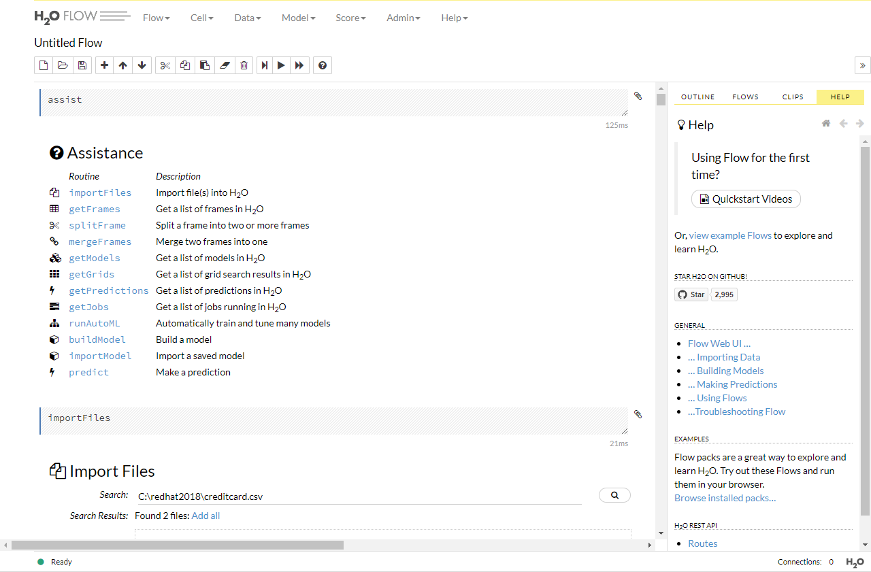
To build the model we used H2O Flow
H2O Flow is an open-source user interface for building H2O models
Very easy to get up in running. Basically download the zip file and run the jar file
unzip h2o-3.16.0.2.zip
cd h2o-3.16.0.2
java -jar h2o.jar
Navigate to http://localhost:54321

Slide 26
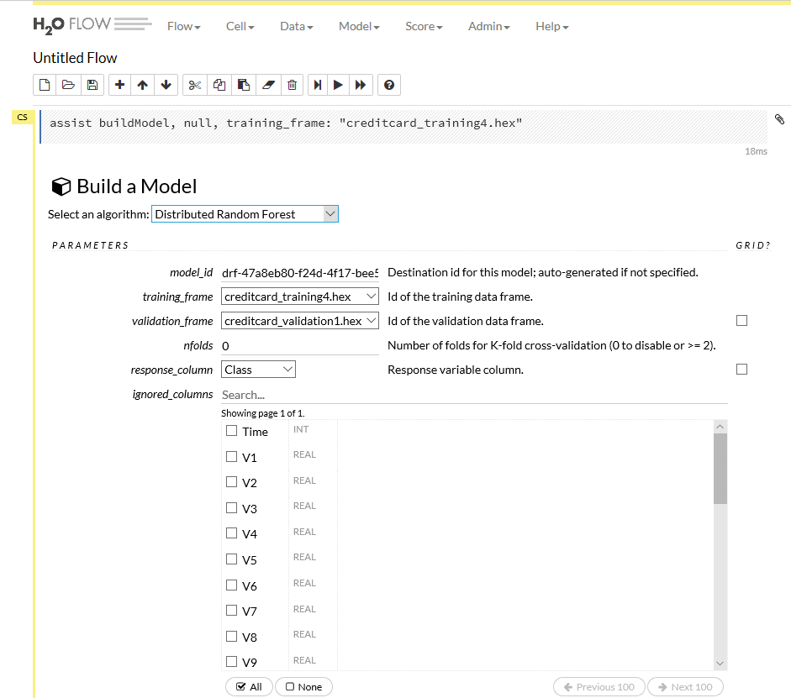
H2O Flow enables you to do multiple trial runs with various algorithms
Important that the training and validation frame are not the same dataset
Response_column is important as this is the data element you are trying to predict

Slide 27
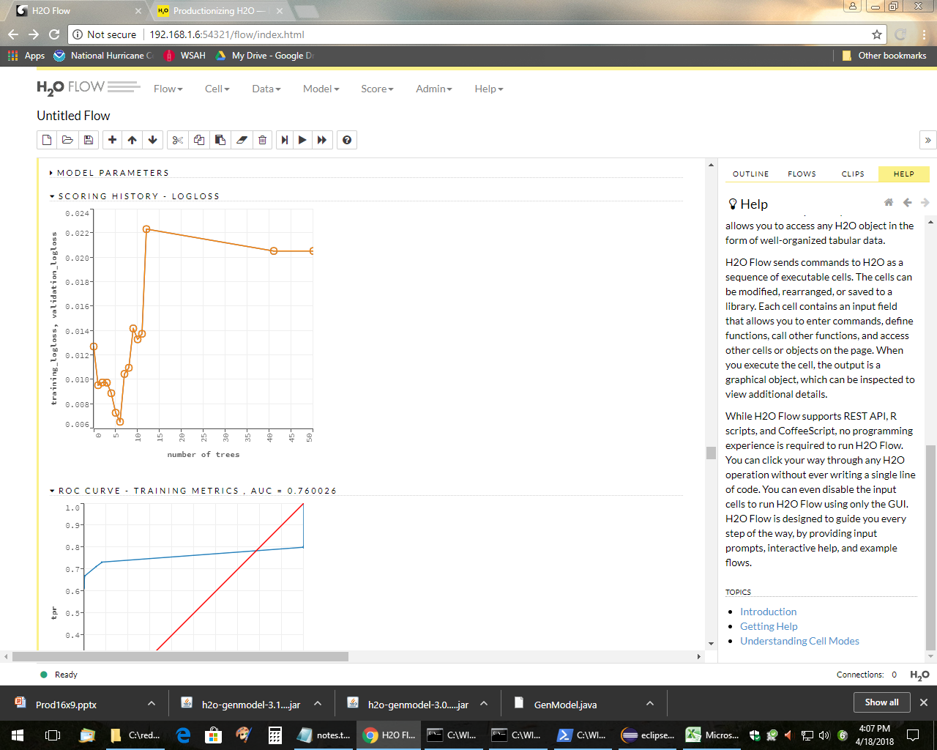
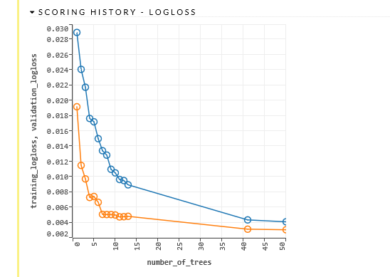
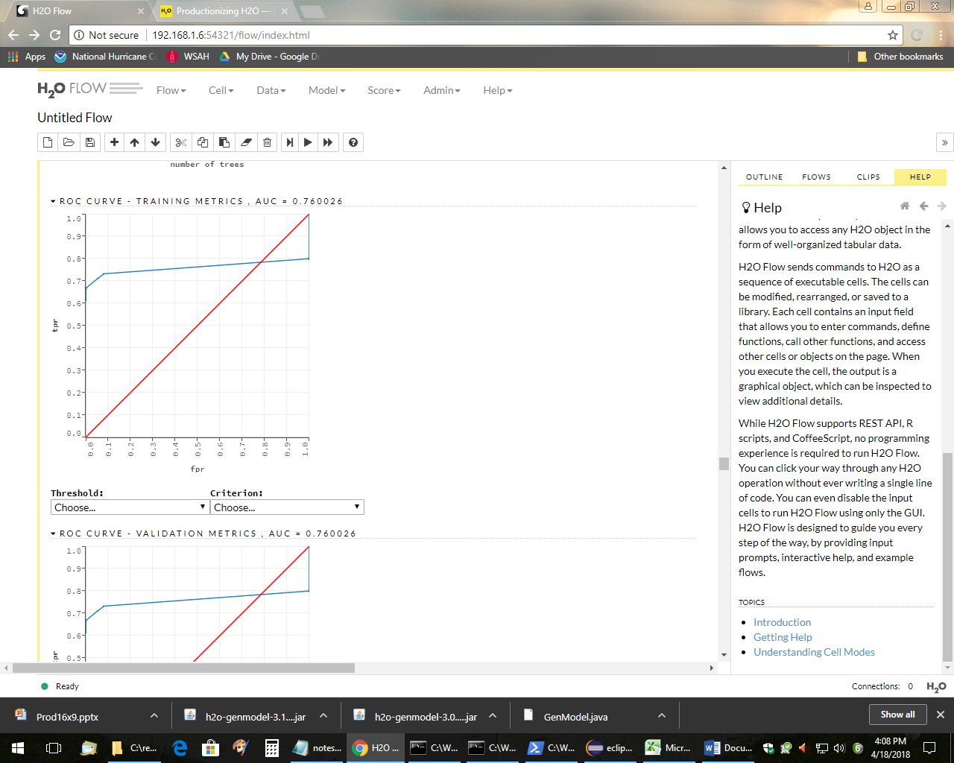
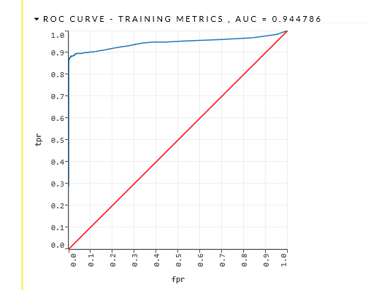
Distributed Random Forest performed better than Gradient Boosting Machine (GBM)
Distributed Random Forest:
GBM:
Distributed Random Forest performed better than Gradient Boosting Machine (GBM) Algorithm
Both Random Forest and GBM are machine learning techniques for regression and classification problems, which produces a prediction model in the form of an ensemble of weak prediction models, typically decision trees.
Random Forest uses deep decision trees, while GBM uses shallower decision trees

Slide 28
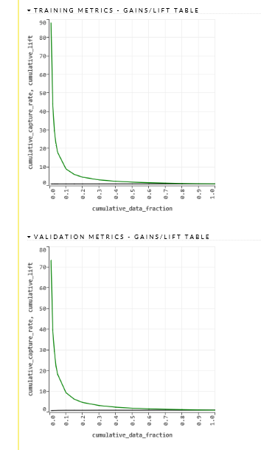
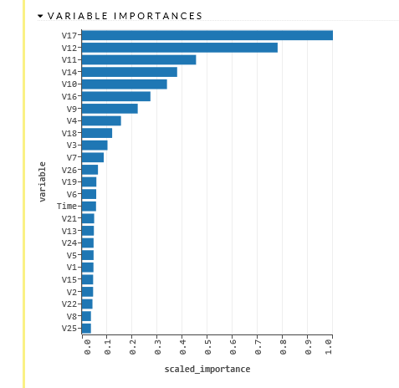
H20 identified which of the features were most important and revised the model until it was accurate

Slide 29
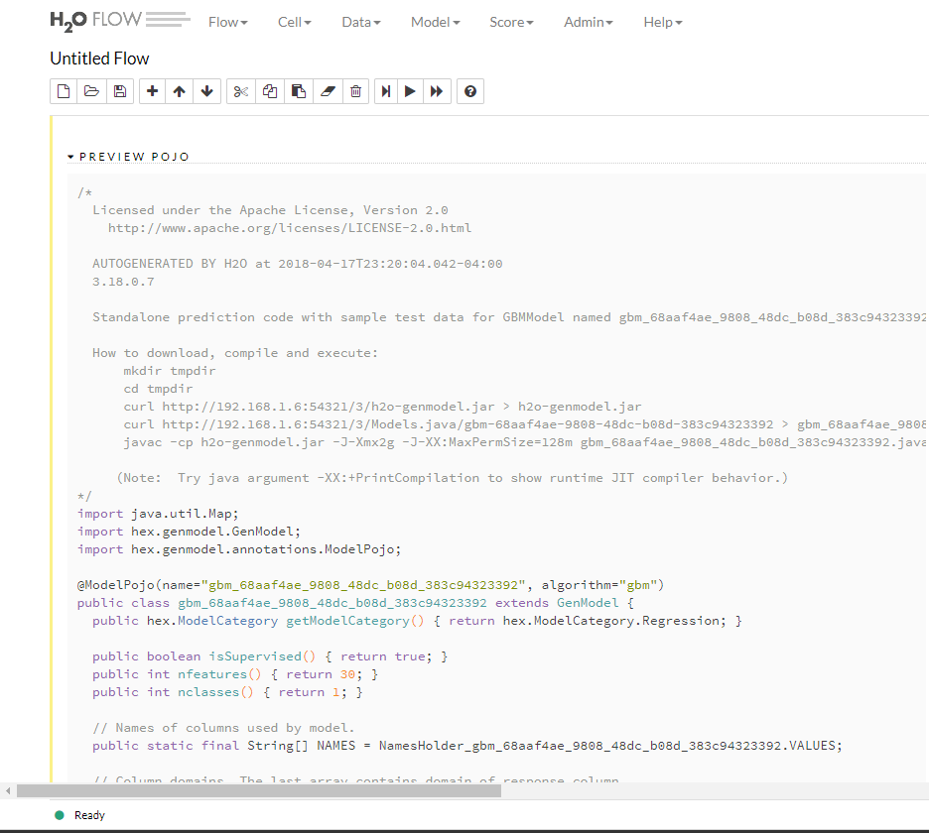
We deployed the H20 model as a POJO
Install H20, java (versions 7 or 8)
Download the kaggle dataset, creditcard.csv
Build the model, selecting the response_column
Download the java generated code for the model and the packed library from the H20 instance
curl -o h20-genmodel.jar http://192.168.1.6:54321/3/h2o-genmodel.jar
curl -o gbm_68aaf4ae_9808_48dc_b08d_383c94323392.java http://192.168.1.6:54321/3/Models.java/gbm-68aaf4ae-9808-48dc-b08d-383c94323392
Compile the java generated code
javac -verbose -cp h2o-genmodel.jar -J-Xmx2g -J-XX:MaxPermSize=128m gbm_68aaf4ae_9808_48dc_b08d_383c94323392.java
Create a main.java to invoke the model with features
javac --cp h2o-genmodel.jar -J-Xmx2g -J-XX:MaxPermSize=128m gbm_68aaf4ae_9808_48dc_b08d_383c94323392.java main.java
Execute the model
java -cp .;h2o-genmodel.jar main
For our demo, we integrated main.java into the RunModelMS Kafka producer/consumer

Slide 30
Live DEMO!

Slide 31
Lessons Learned of this approach
Coordinator can be a single of point of failure
-Evaluate multi-deployment for active/active (application and database layers)
Need a Unique ID (correlation ID ) that goes across all microservices
For the machine learning dataset, use big data and unbiased data
Leverage Chaos testing to validate resilency
Apply this pattern where :
-there are synchronous blocks of asynchronous processing
-there is a need to see the overall all end to end business process at design time and run-time
-there is a need to decouple as much as possible to eliminate dependencies

Slide 32
References
Github repo for demo
https://github.com/andy9876/MachineLearningReactiveBPM
Microservices: When to react vs. orchestrate
https://medium.com/capital-one-developers/microservices-when-to-react-vs-orchestrate-c6b18308a14c
A Reactive Framework Comparison
https://medium.com/capital-one-developers/building-microservices-a-reactive-framework-comparison-fb49d8f3c8f4
Comparing and Contrasting Open Source BPM Products
https://medium.com/capital-one-developers/comparing-and-contrasting-open-source-bpm-projects-196833f23391

Slide 33
THANK YOU
plus.google.com/+RedHat
facebook.com/redhatinc
linkedin.com/company/red-hat
twitter.com/RedHat
youtube.com/user/RedHatVideos

Slide 34
Appendix

Slide 35
ECS setup
Create cluster
Create task definitions
Create service

Slide 36
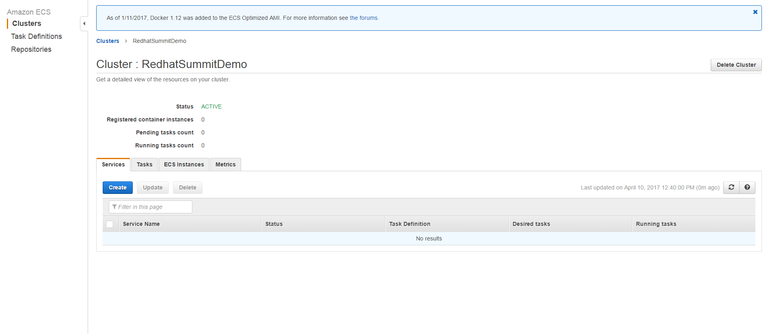
Create Cluster

Slide 37
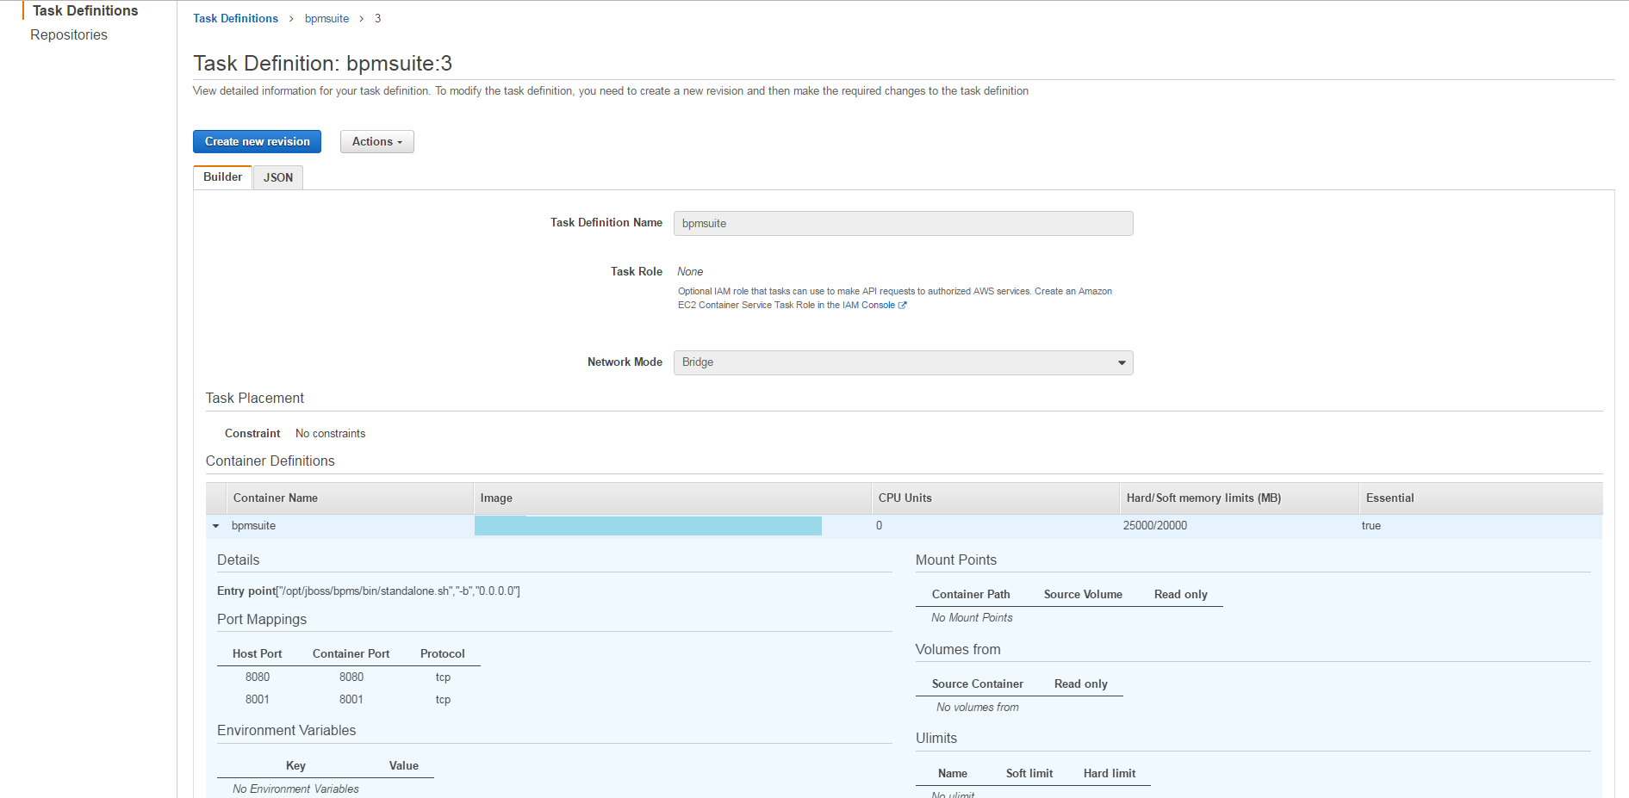
Create Task Definitions

Slide 38
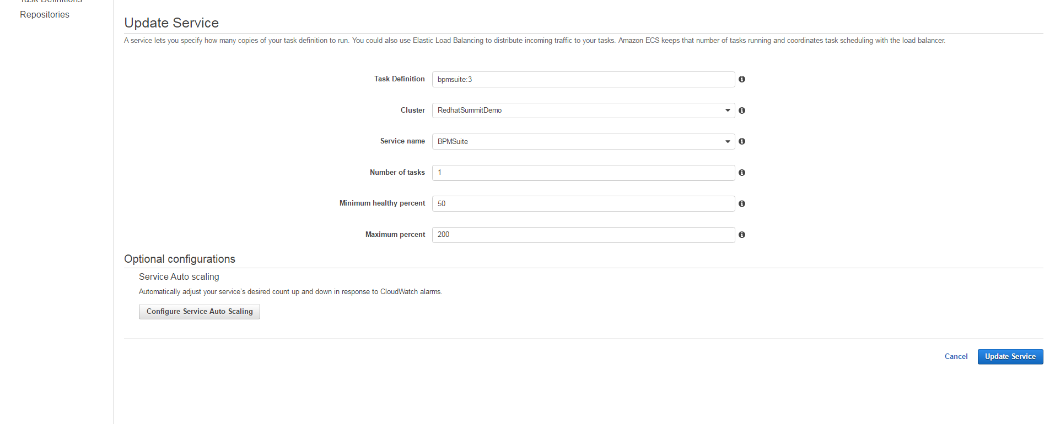
Create Service

Slide 39
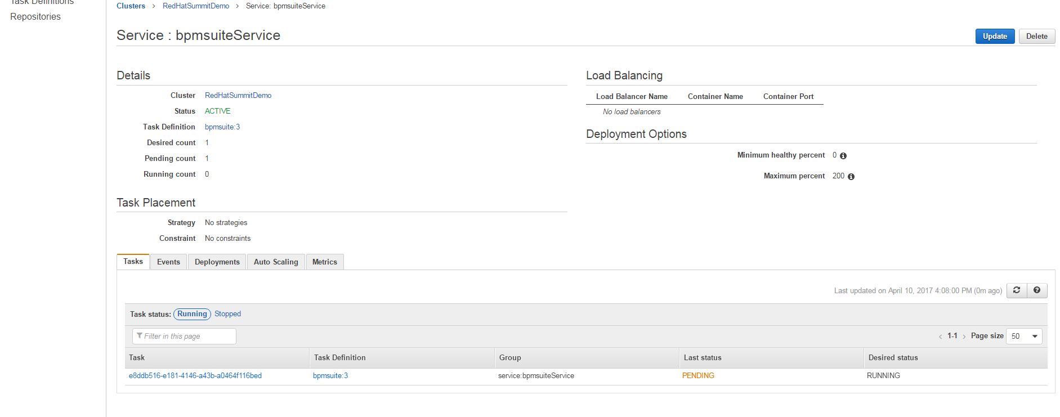
ECS deploys the container to the ECS Cluster

Slide 40
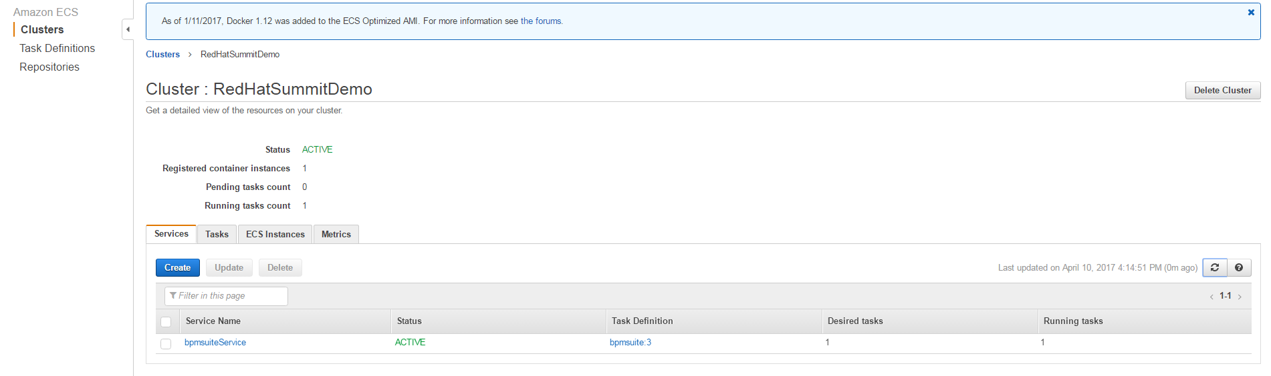
Task is deployed successfully

Slide 41
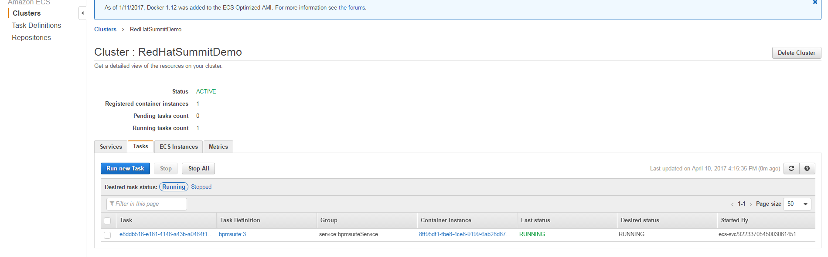
Task is deployed successfully

Slide 42
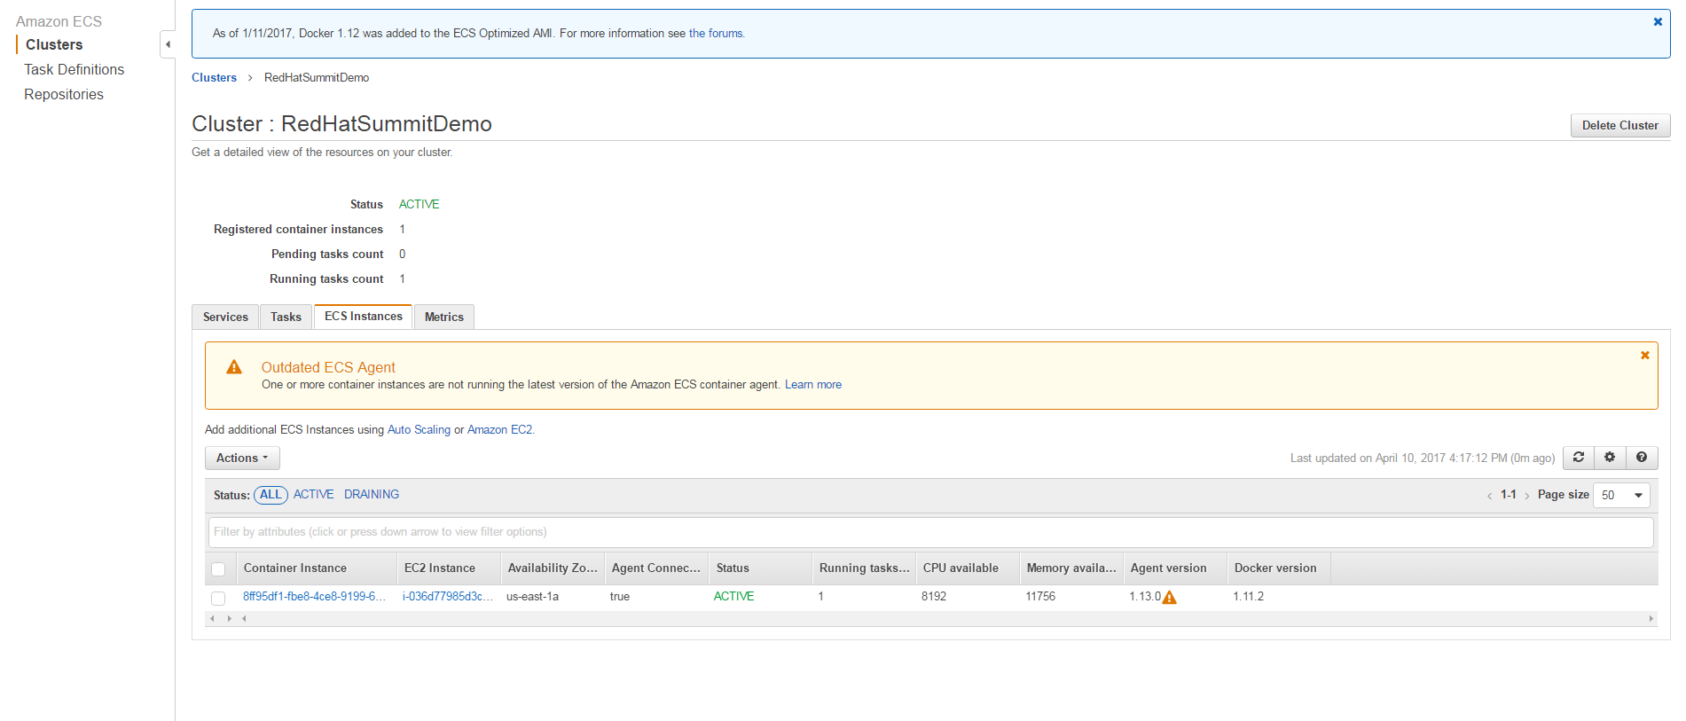
EC2 Container Instance is running

